Slide 1


S
Statutory Meeting
Rotary Club Luxembourg-Hearts
12 July 2023
Title Page Option

Slide 2

Agenda:
Welcome and Introduction
Rotary Club Luxembourg Hearts Initiatives
Calendar next events

Slide 3
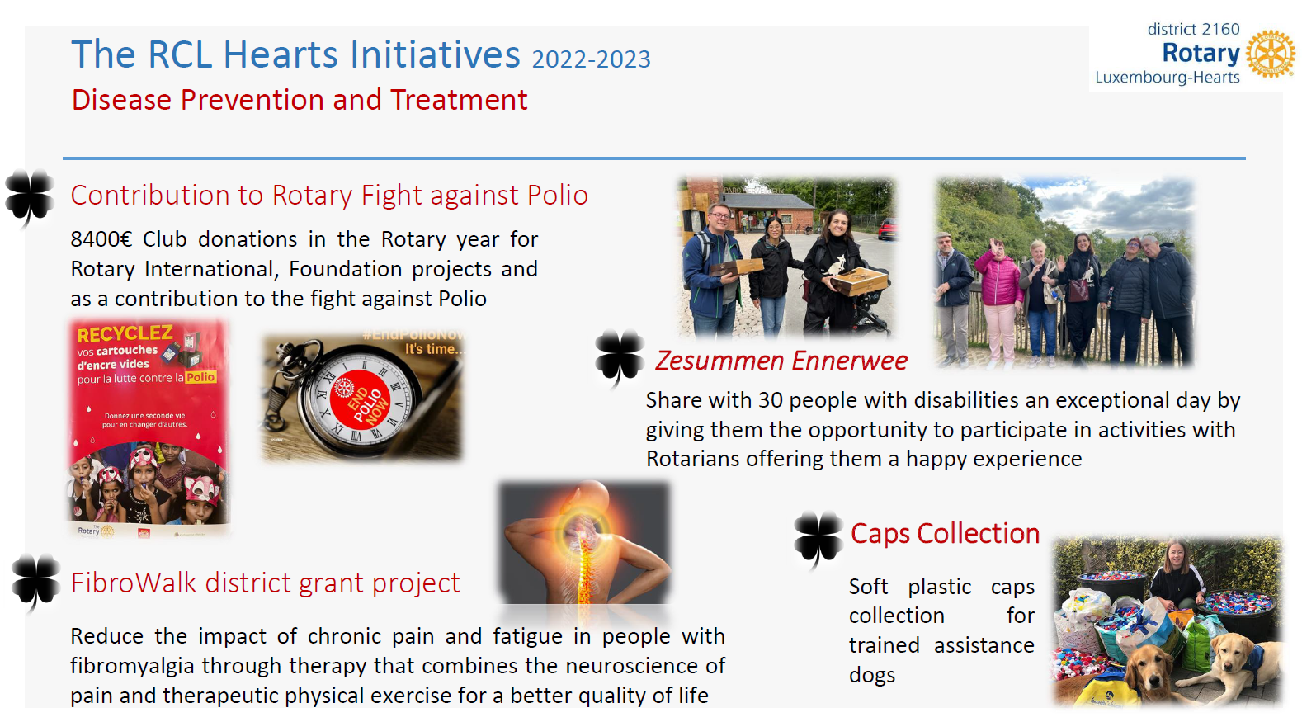

Next Club Events

Slide 4
RCL Hearts Initiatives 2023 / 2024
Date | Project name | Goal | Short description
6 September 2023 | Japanese Event | Arcus’ programme on animal-assisted pedagogy and therapy for children and teenagers living in “Kannerhaiser” | conference on Japanese art and design, combined with sake testing in c
24 September 2023 | Zesumme Ennerwee | n/a | Rotarians help handicap people during one day (prepare food and accompany them
September / October 2023 | Mashrooms picking | Club fundraising | Family event organised to integrate the members, promote healthy life style and raise money for the club fundraising.
December 2023 | Art Event | Club fundraising | Family event organised to integrate the members, combine Jorge Bayo art and raise money for the club fundraising.

Slide 5
RCL Hearts Initiatives 2023 / 2024
May | ING Marathon | End Polio Now fundraising | Yearly family event organised with other Luxembourg Rotary Clubs. Runners from our club contacted everyone in their address book to ask for sponsorship!
2023-2024 | Laptop 4 Schools | The Goal of this service is to support schools in need of IT equipment, to the benefit of students in difficult financial situations or to facilitate long-distance learning. | With this Project our Club aims at fulfilling two of the seven Rotary's areas of focus: "Basic education and literacy" and "Supporting the environment". We help coordinate the donation of decommissioned IT equipment to students in need: very good computers that otherwise would have been disposed can still be used for many years to support student's education. The decommissioned IT equipment is sourced from donations of Luxembourghish organisations to our Club. We coordinate repairs and formatting of hard drives (if necessary) and shipment to the final beneficiary.
June 2024 | Rotary Hearts 10th birthday | Club fundraising | To promote Rotary and Rotary Hearts especially to make us more visible
July 2024 | Europe 4 Europe | Promote youth awareness of the European Union | Every two years 28 young adults 18-20 years old from 28 EU members states will tour the 6 founding EU member states together to learn more about the EU. In Luxembourg our Club hosts the event. In the past the program included visits to European institutions like EIB, ECJ as well as the IBBL.
date tbd | Wine against Polio | End Polio Now fundraising | tbd
date tbd | Micro Finance Support |  | MicroLoans for women entrepreneur in developing countries

Slide 6
Calendar reminder
Next meetings:
6 September Japanese Event
24 September Zesummen Ennerwee
27 September Statutory Meeting RCL Hearts

